Slide 1
Graphic charter for smashing magazine web site

Slide 2
What does the « Graphic charter » term means?
The graphic charter is a deliverable that guarantees a project’s consistent graphical identity. It defines the overall graphic, iconographic, typographic and ergonomic guidelines that should be followed on the site. It helps to guide and streamline integration, adaptation and utilisation of the various communications channels. Drafted at the end of a project, based on model templates, it is presented in the form of a PDF document (in print or online).

Slide 3
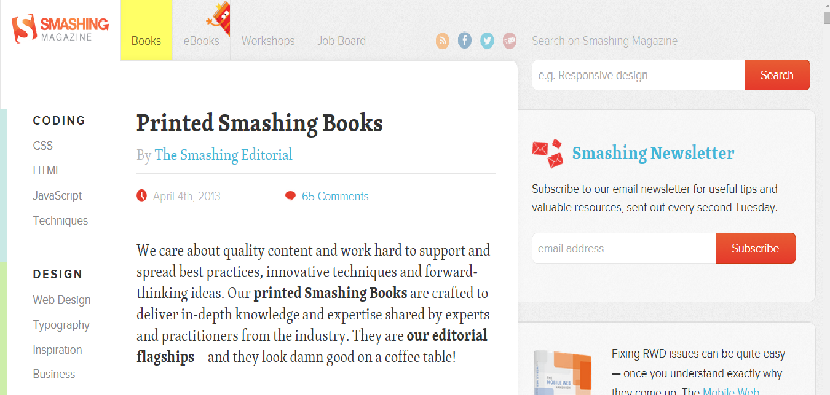
My width is: 367 px
My Height is : 96 px
My horizontal resolution =
MyVertical resolution= 96ppp
~QUICK VIEW~

Slide 4
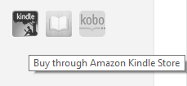
USED ICONS:
How can you contact the magazine:
RSS-FEED
Facebook Page
Tweeter
Email Newsletter
How can you buy their books:

Slide 5
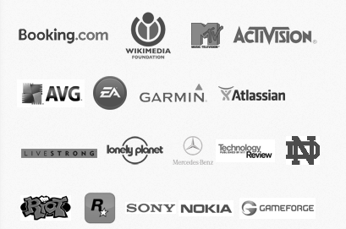
Who are their partners:
(We are proudly hosted on Media Temple Dedicated Servers. Performance matters.)
Their Offers:
(Smashing Job Board)
How can you evaluate them:
✎ Write for us
0,42
0,53
What date/time it is:
0,42
0,53

Slide 6
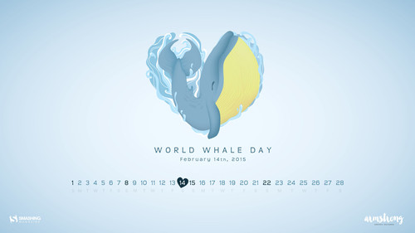
USED PICTURES:
Wallpapers they provide:

Slide 7
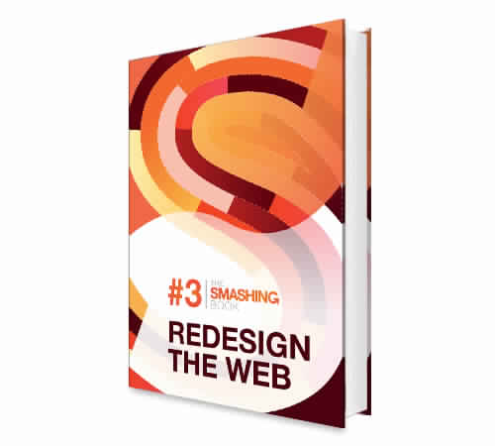
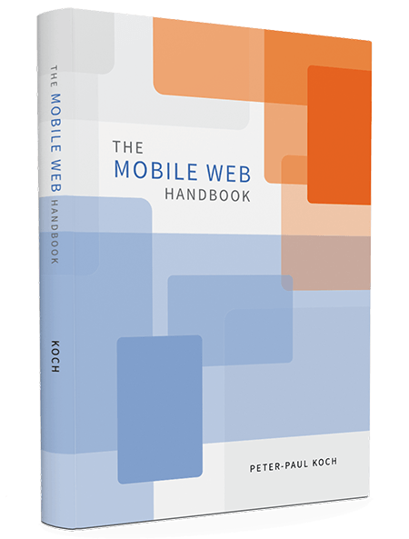
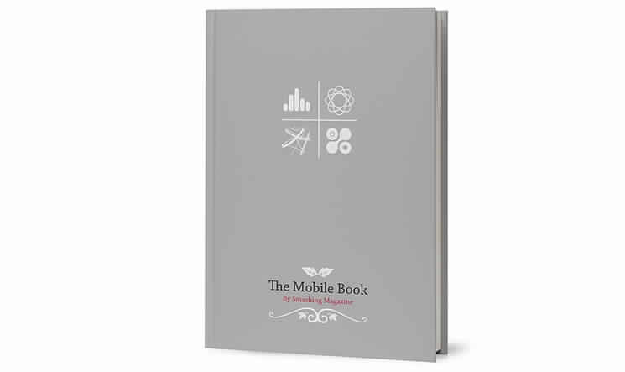

Slide 8
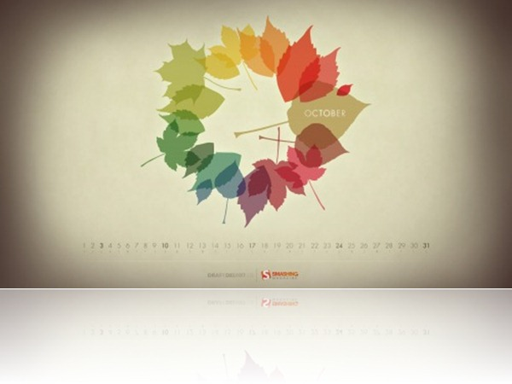

Slide 9
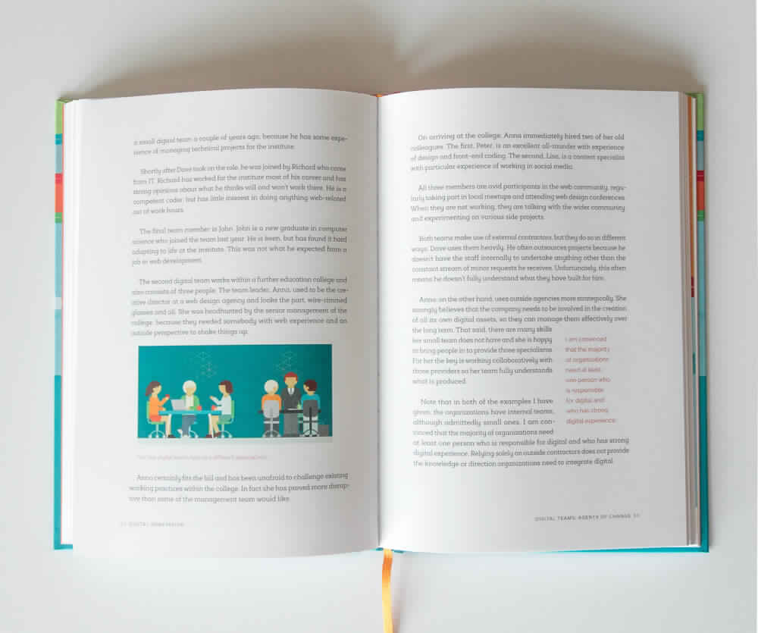
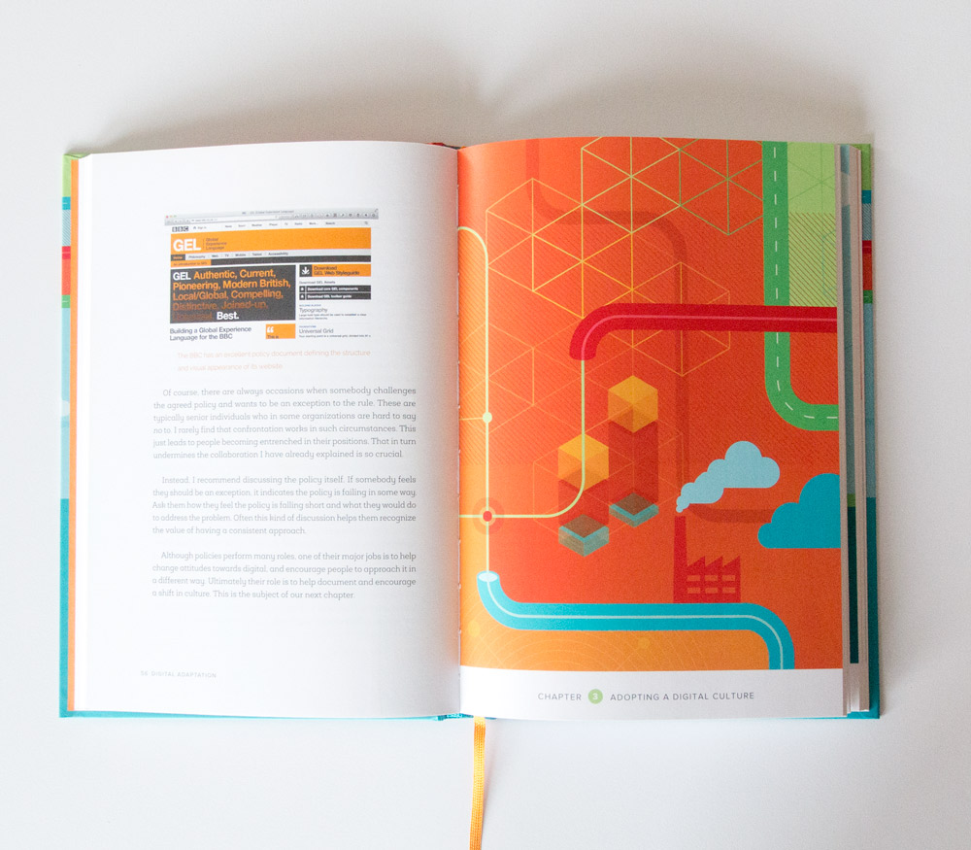
Books’s Samples:

Slide 10
Books’s Authors:
Peter-Paul Koch (PPK)
Wrote:
Mobile Web Handbook
Paul Boag
Wrote:
Digital Adaptation

Slide 11
Advertsisements:

Slide 12
USED FONTS:
Consolas:
Eg: position fixed, overflow: auto and background-attachment
Georgia
Eg: Printed Smashing Book ( bold)
Mobile Web Handbook — Now Shipping! (normal)
Cambria
Eg: By The Smashing Editorial
Segoe UI
Eg: TABLE OF CONTENTS (bold)
With a commitment to quality content for the design community. ( Italic) Founded by Vitaly Friedman and Sven Lennartz. 2006-2015. ( Normal)
Made in Germany. ✎ Write for us – Contact us – Impressum.
@smashingconf (Normal)
(e.g. CSS/JS architecture, Sass, LESS, maintanence) ( Italic)
Arial
Eg: Here’s Why You Should Subscribe ( Bold)
Email us at techjobs@beachfrontmedia.com
A conference full of tangible, actionable insights (Normal)
Verdana
Eg: CREATING A ROBUST WORKFLOW by RACHEL ANDREW
Calibri (for the body)
Eg: Read more…
Calibri Light (Titles)
Eg: Smashing Jobs
Times New Roman
Eg: Beachfront Media (Ormond Beach, FL)

Slide 13
Common Point between all these links, it’s #4ABFEE BLUE!! ☺

Slide 14
USED BUTTONS:
5,58 cm
1,56cm
8,84 cm
1,11 cm
10,29cm
1,91 cm
5,5 cm
11,1 cm
1,09 cm
10,88cm
8,84 cm
1,88 cm
15,53cm
1,11 cm
5 cm
1,22 cm
9,69 cm
6,96 cm
1,85 cm
1,96 cm
1,06 cm
4,08 cm
9,63 cm
7,73 cm
1,88 cm
5 cm
1,96 cm
0,95cm

Slide 15
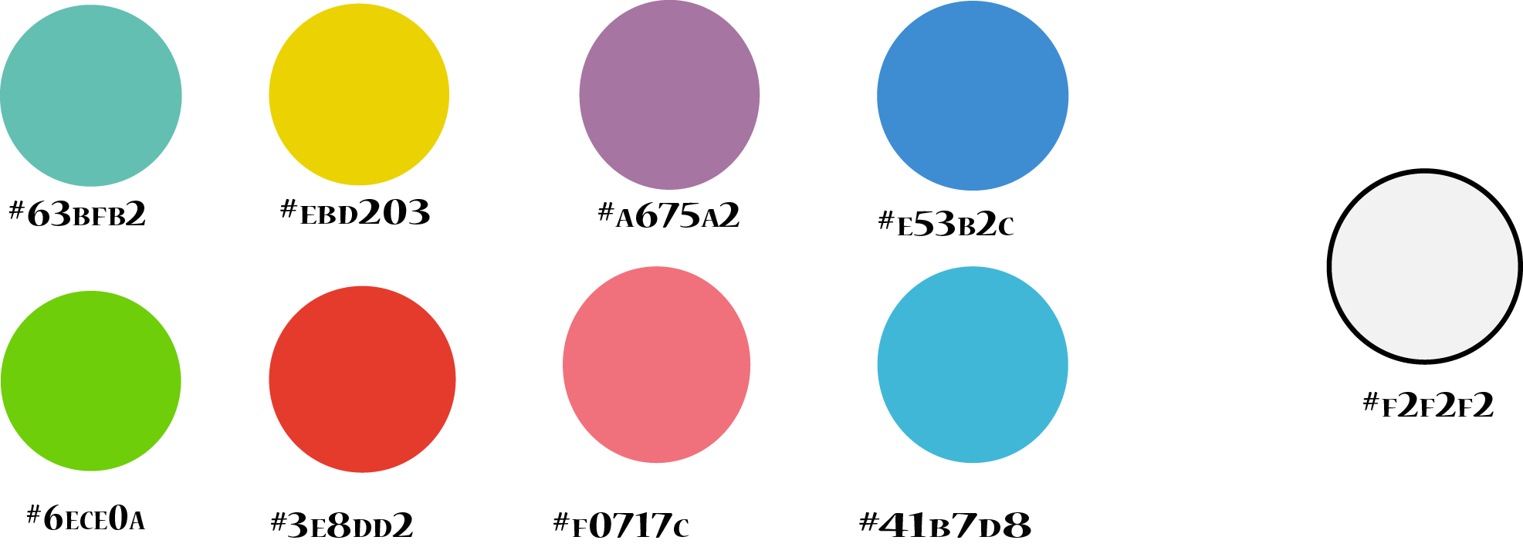
USED COLORS:

Slide 16
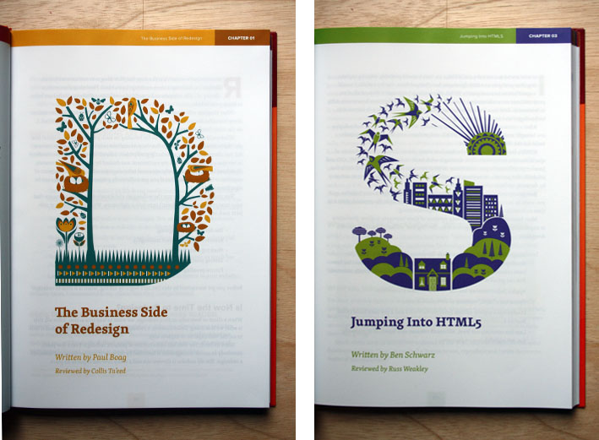
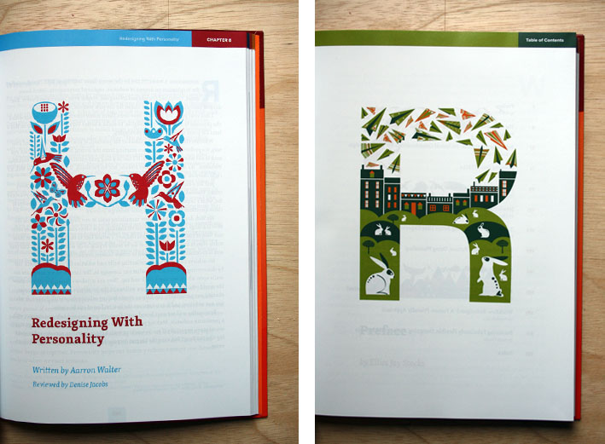
Pictures that inspired us:

Slide 17
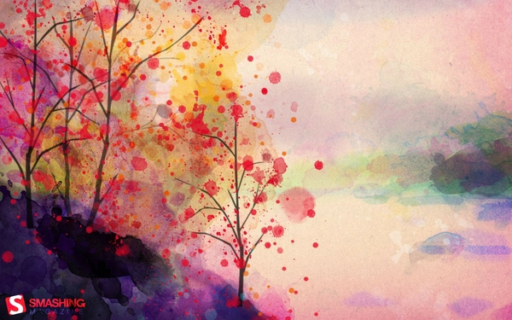

Slide 18
Thank you for paying attention ☺

